Slide 1
STOCK ANALYSIS AND PREDICTON USING MACHINE LEARNING

Slide 2
TABLE OF CONTENT
Understanding the Problem Statement
Linear Regression
k-Nearest Neighbors
Auto ARIMA
Prophet
Long Short Term Memory (LSTM)

Slide 3
Understanding the Problem Statement
We’ll dive into the implementation part of this article soon, but first it’s important to establish what we’re aiming to solve. Broadly, stock market analysis is divided into two parts – Fundamental Analysis and Technical Analysis.
Fundamental Analysis involves analyzing the company’s future profitability on the basis of its current business environment and financial performance.
Technical Analysis, on the other hand, includes reading the charts and using statistical figures to identify the trends in the stock market.

Slide 4
There are multiple variables in the dataset – date, open, high, low, last, close, total_trade_quantity, and turnover.
The columns Open and Close represent the starting and final price at which the stock is traded on a particular day.
High, Low and Last represent the maximum, minimum, and last price of the share for the day.
Total Trade Quantity is the number of shares bought or sold in the day and Turnover (Lacs) is the turnover of the particular company on a given date.
Another important thing to note is that the market is closed on weekends and public holidays.

Slide 5
Linear Regression
Introduction
The most basic machine learning algorithm that can be implemented on this data is linear regression. The linear regression model returns an equation that determines the relationship between the independent variables and the dependent variable.
The equation for linear regression can be written as:
Here, x₁, x₂,….x_{n} represent the independent variables while the coefficients θ₁, θ₂, …. θ_{n} represent the weights.

Slide 6
RMSE RESULT
121.16
The RMSE value is high, which clearly shows that linear regression has performed poorly.

Slide 7
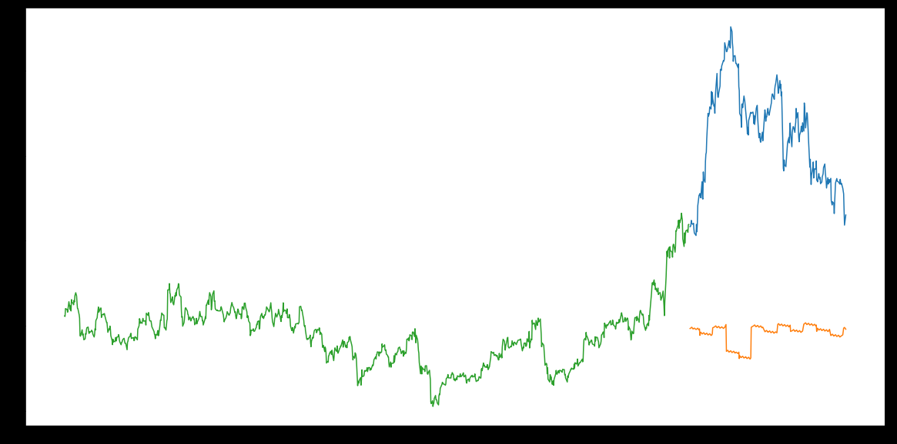

Slide 8
k-Nearest Neighbours
Introduction
Another interesting ML algorithm that one can use here is kNN (k nearest neighbours). Based on the independent variables, kNN finds the similarity between new data points and old data points.

Slide 9
RMSE RESULT
115.17
There is not a huge difference in the RMSE value.

Slide 10
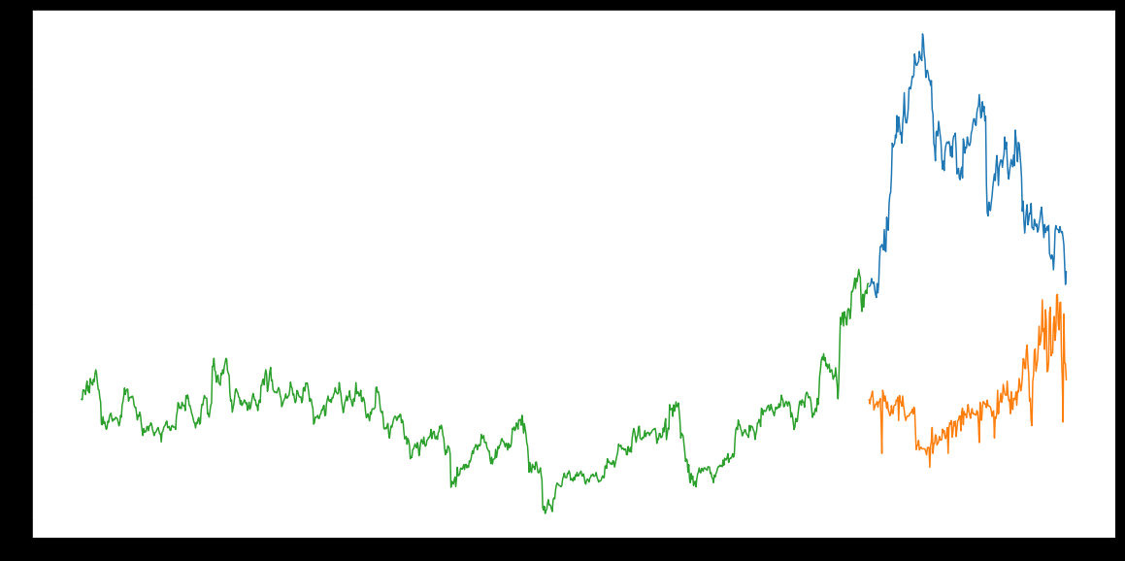

Slide 11
AUTO ARIMA
ARIMA is a very popular statistical method for time series forecasting. ARIMA models take into account the past values to predict the future values. There are three important parameters in ARIMA:
p (past values used for forecasting the next value)
q (past forecast errors used to predict the future values)
d (order of differencing)
Parameter tuning for ARIMA consumes a lot of time. So we will use auto ARIMA which automatically selects the best combination of (p,q,d) that provides the least error.

Slide 12
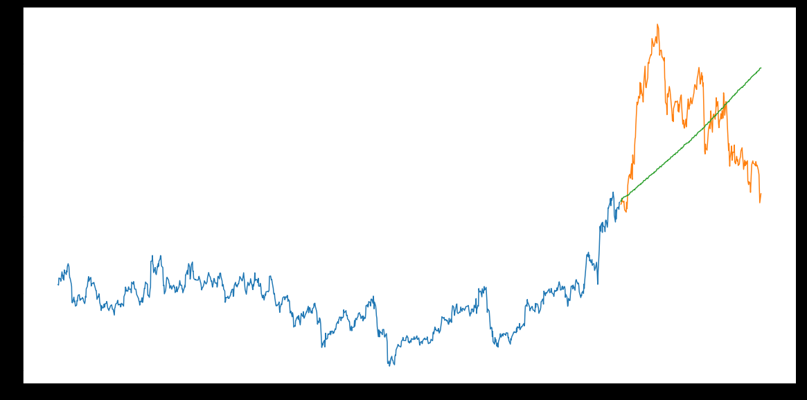
RSME RESULT:44.95 Although the predictions using this technique are far better than that of the previously implemented machine learning models, these predictions are still not close to the real values.

Slide 13
PROPHET
There are a number of time series techniques that can be implemented on the stock prediction dataset, but most of these techniques require a lot of data preprocessing before fitting the model. Prophet, designed and pioneered by Facebook, is a time series forecasting library that requires no data preprocessing and is extremely simple to implement. The input for Prophet is a dataframe with two columns: date and target (ds and y).
Prophet tries to capture the seasonality in the past data and works well when the dataset is large.

Slide 14
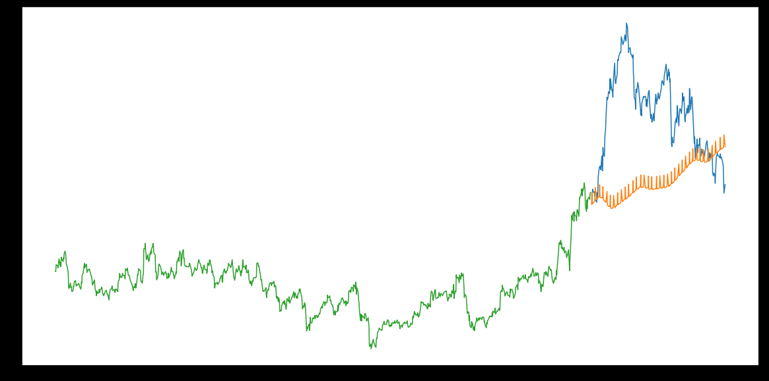
RMSE RESULT:57.49 Prophet (like most time series forecasting techniques) tries to capture the trend and seasonality from past data. This model usually performs well on time series datasets, but fails to live up to it’s reputation in this case.

Slide 15
Long Short Term Memory (LSTM)
LSTMs are widely used for sequence prediction problems and have proven to be extremely effective. The reason they work so well is because LSTM is able to store past information that is important, and forget the information that is not. LSTM has three gates:
The input gate: The input gate adds information to the cell state
The forget gate: It removes the information that is no longer required by the model
The output gate: Output Gate at LSTM selects the information to be shown as output

Slide 16
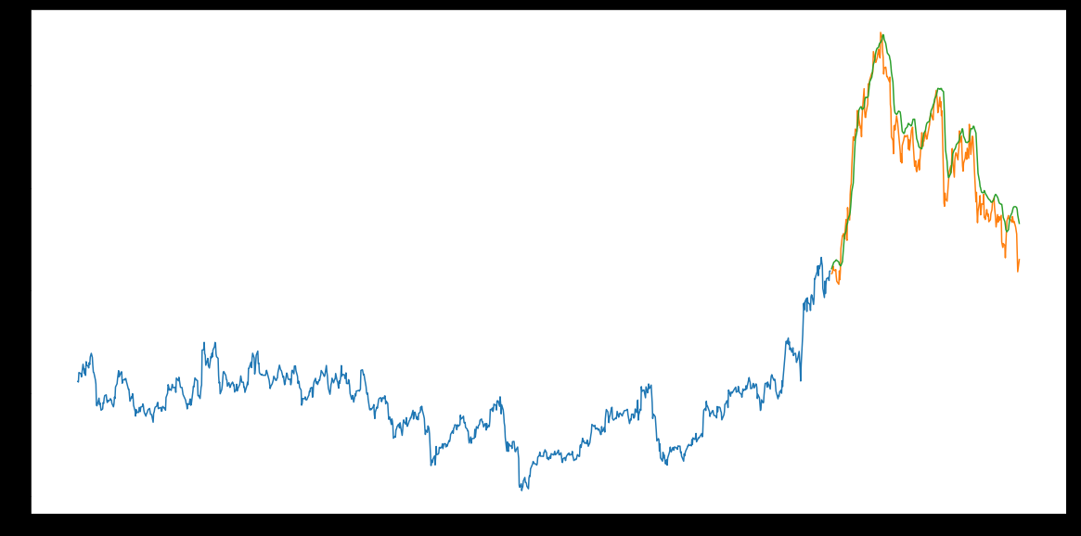
RMSE RESULT:11.77 The LSTM model can be tuned for various parameters such as changing the number of LSTM layers, adding dropout value or increasing the number of epochs.

Slide 17
HENCE, WE USE LSTM CONCEPT FOR OUR MODEL.

